Slide 1
RECURRENT CONVOLUTIONAL NEURAL NETWORK FOR SENTENCE CLASSIFICATION
Bharath Elangovan (A20344918)
Guru Prasad Natarajan (A20344932)

Slide 2
INTRODUCTION
Natural language processing (NLP) is a field of computer science, artificial intelligence, and computational linguistics concerned processing the given set of corpus based on the NLP task.
We have experimented to see if our implementation is more accurate and robust than the conventional method.
We have implemented traditional Naïve Bayes and Logistic Regression
We have implemented Recurrent Neural Network, Convolutional Neural Network and Recurrent Convolution Neural Network.

Slide 3
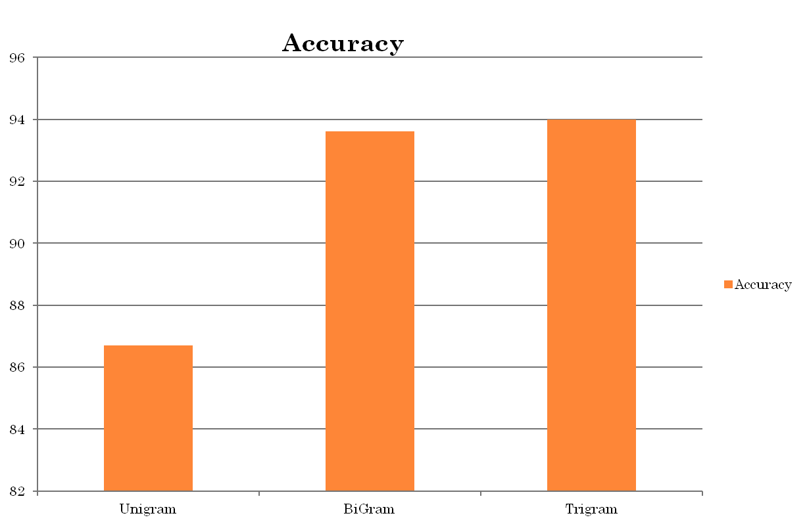
LOGISTIC REGRESSION ACCURACY

Slide 4



RECURRENT NEURAL NETWORKS
A recurrent neural network (RNN) is a class of artificial neural network where connections between units form a directed cycle.
Experimented manual implementation of RNN and by using Keras library.
In the manual implementation of RNN we have used three hidden layers with a cyclic network as a feedback loop.

Slide 5
CONTD..
Y^
V
1,z1,z2,…zn
Z
W
1,q1,q2,……qm
Q
S
X
1,x1,x2,……xm

Slide 6
CONVOLUTIONAL NEURAL NETWORK(CNN)
Widely used in the field of NLP.
Built a sequential model.
Selection of hyperparameters
- Number of filters, grams, word embedding, dropouts.
Layers and the activation functions used
- ReLU for the 1-D convolution layer
- Sigmoid elsewhere.

Slide 7
RECURRENT CONVOLUTIONAL NETWORK
We use the same setting that is used for CNN in RCNN.
Word representation is done by taking a individual words and adding embedding dim.
The above process is followed by a 1-D convolution layer.
Text representation is done by applying a max-pooling layer.

Slide 8
RECURRENT CONVOLUTIONAL NETWORK(CONT.)
Word embeddings are calculated can be calculated by either gensim models or google’s word2vec implementation (for static or non-static mode)
The output from the max-pool layer is fed into the recurrent layer.
The recurrent layer is an implementation of the LSTM(Long Short Term Memory)
The output from the LSTM is fed into the output layer, which gives the class of the sentence.

Slide 9
ADDITIONAL DETAILS
Added dropout probability wherever possible.
Used a stride of 1.
Solution to the data sparsity problem.
Tried the model with various optimizers and loss functions.

Slide 10
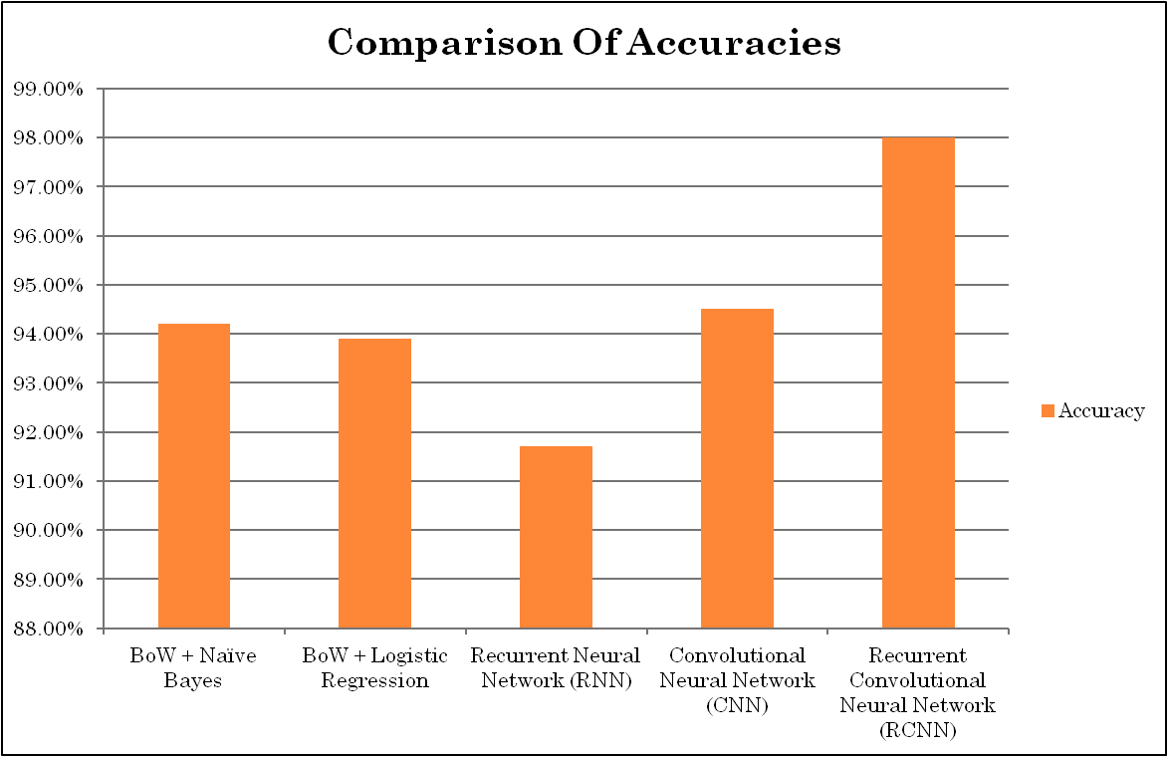
COMPARISON OF MODELS

Slide 11
RESULTS
Compared the model built with the traditional techniques.
Also compared the result with CNN and RNN.
Results show that RCNN outperformed the other models and can be declared as a dependable model for sentence classification

Slide 12
THANK YOU

